Slide 1

Creation Lightship Lightbeing
www.CreationLightship.com
Original jpg format

Slide 2

Creation Lightship Lightbeing
www.CreationLightship.com
Original jpg format

Slide 3

Creation Lightship Insignia
www.CreationLightship.com

Slide 4

Original png format
Creation Lightship Lightbeing
www.CreationLightship.com

Slide 5
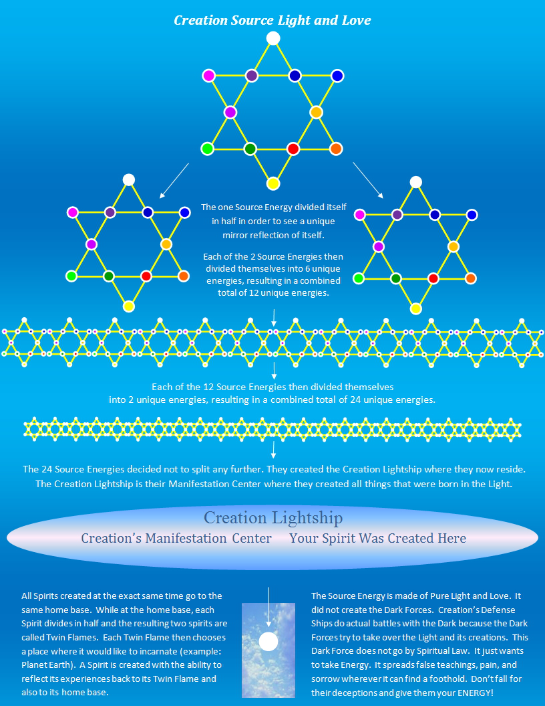
Creation Process Diagram
www.CreationLightship.com

